Slide 1
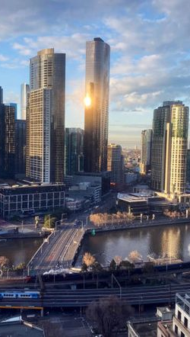
Data Analysis of Real Estate in Melbourne, Australia
Kyeremateng martin

Slide 2

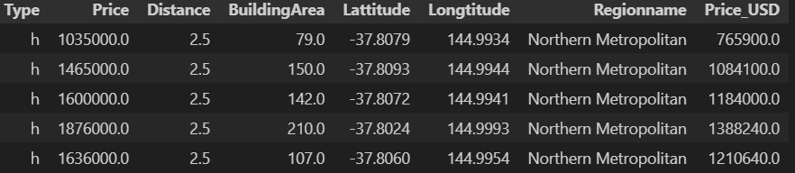
Introduction
Objective: To analyze the real estate market in Melbourne using various data analysis techniques to examine the impact of various factors on market price.
Dataset Description: The dataset includes detailed information on properties sold in Melbourne, capturing attributes such as address, property type, suburb, sale method, number of rooms, price, real estate agent, and distance from CBD, with 21 columns and 13,580 observations in each column.

Slide 3

Research Questions
Main Research Question:
How do key attributes impact housing prices in Melbourne?
Sub-questions:
Which region has the highest real estate prices?
Which property type commands the highest market price?
Does building area affect market price?
What is the impact of location on property prices?

Slide 4
Data Preprocessing
Data Wrangling: Using Jupyter Notebook, the data was loaded into a python DataFrame and a wrangle function created to preprocess and clean the data.
Libraries Used: The necessary libraries were imported and data explored to identify key attributes that are suitable for the analysis. Background research was done to know the range of values that a typical real estate data and its attributes should have in order to be able to identify outliers and clean the data. We used Python libraries such as Pandas, NumPy, Plotly.express, Sklearn.preprocessing, QuantileTransformer, Matplotlib.pyplot , Seaborn for data manipulation and visualization, and also SimpleImputer library to handle missing values.
Cleaning Steps: Data was cleaned by handling missing values using SimpleImputer library, normalized some distributions for analysis, and attributes which were not of greater need to our analysis dropped successfully. A target vector/variable [Price_aud] was chosen for analysis based on the research question to determine how each feature (categorical/numerical) affects the target vector. The target {Price_aud] was in Australia dollar and we converted to United States dollar to create a general market price that could easily be understood by even the layman. The 13,580 observations was lowered to 2,860 after the cleaning. Key Columns used: Type; Latitude, Longitude, BuildingArea, Distance, Price [USD}

Slide 5
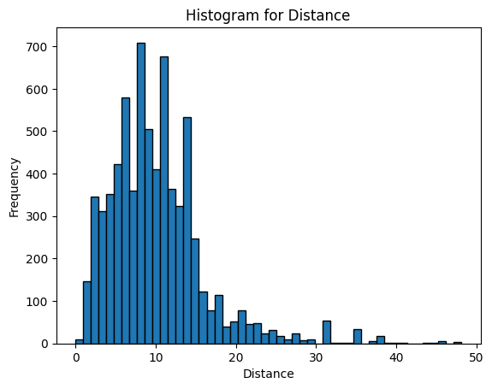
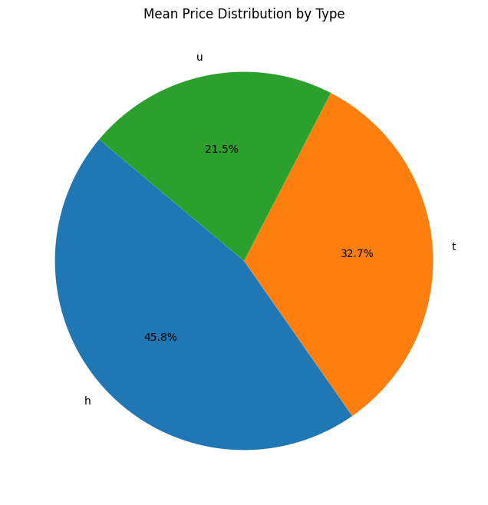
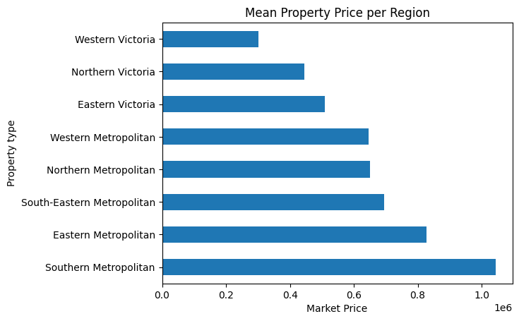
Pie Chart
Histogram
Histogram: Displays the distribution of property prices, showing a right skewed distribution, which indicates a mode of clustered lower-priced properties with a few high-priced properties.
Bar Chart
Property Type | Mean Market Price [USD] | Percentage Mean
h - house,cottage,villa, semi,terrace | 935,245.957169 | 45.8%
t - townhouse; developing site, other residential | 667,507.453353 | 32.7%
u - unit, duplex. | 438,562.387967 | 21.5%
Pie Chart: Represents the distribution of different property types, with h-house, cottage, villa, terrace, semi being the most expensive.
Bar Chart: Shows average property prices by region, highlighting Southern Metropolitan as the most expensive.

Slide 6
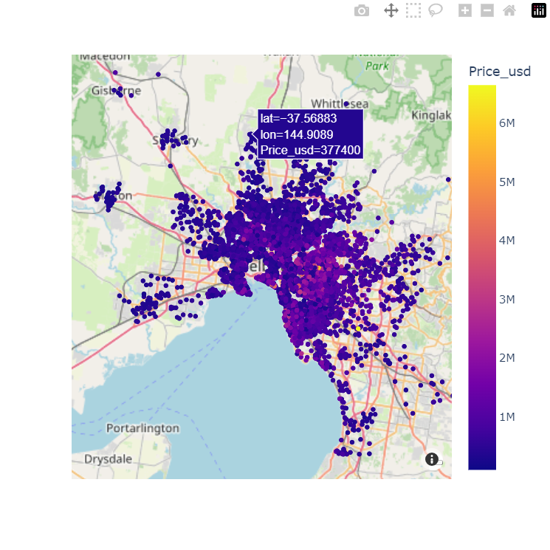
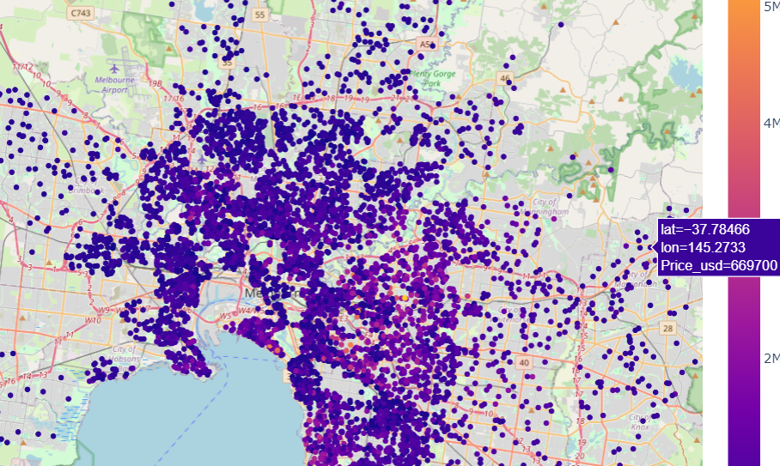
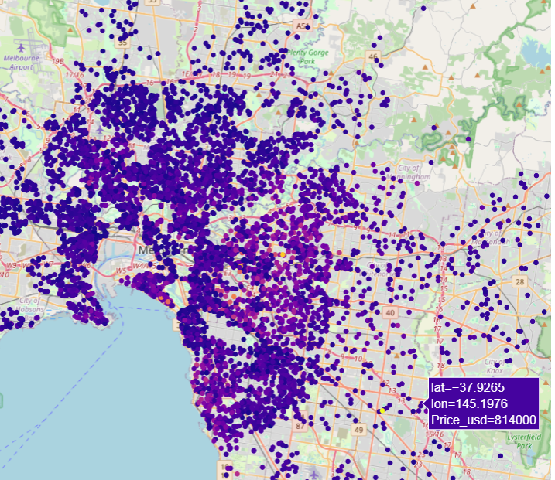
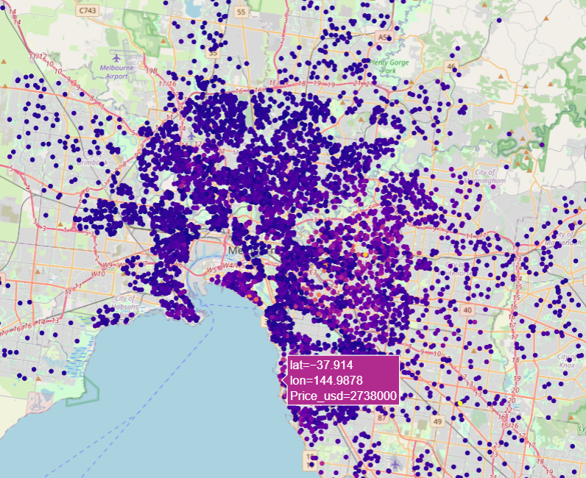
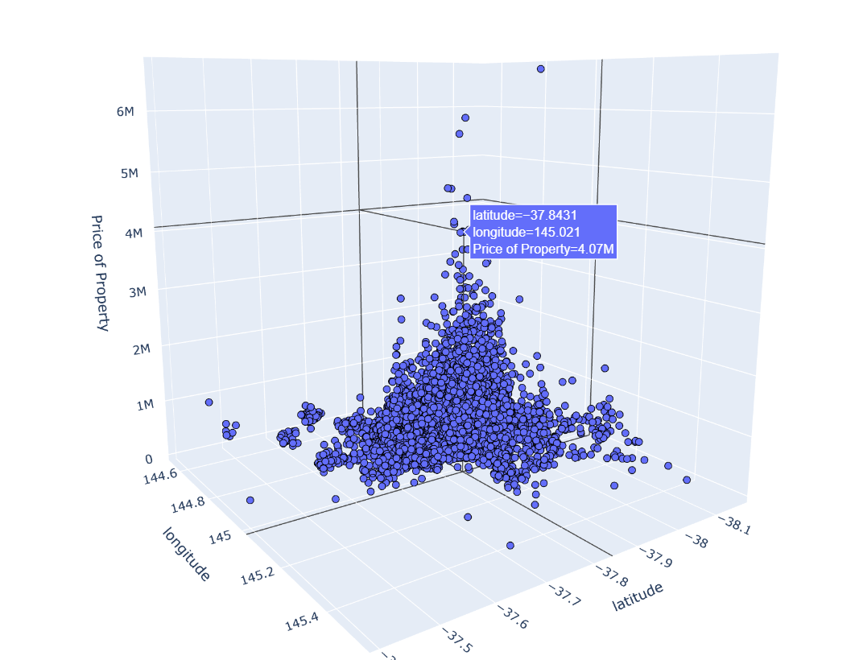
A 3-D plot showing relationship between location of property and market price

Slide 7
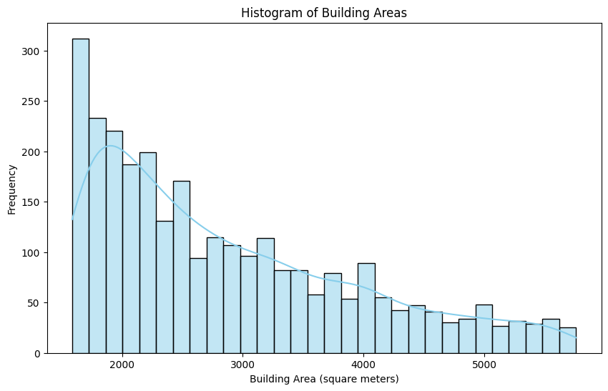
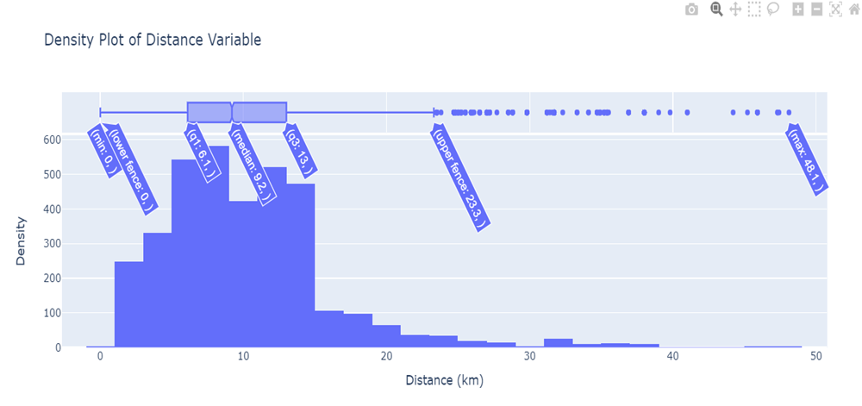
Box-Plot
Histogram
The histogram of building areas presents a distribution where frequencies of different building sizes are plotted. Key observations:
Peak Frequency: The highest frequency is for building areas around 1600-2000 square meters, with the highest bar at around 300 properties.
Distribution Shape: The distribution shows a decreasing frequency as building areas increase, forming a right-skewed pattern rather than a normal distribution.
Range: The building areas range from below 1000 square meters to over 5000 square meters.
Frequency Decrease: The frequency of larger building areas steadily decreases, indicating fewer properties with larger sizes.
Outliers: There are fewer properties with very large building areas (above 5000 square meters), showing a long tail on the right side.
This right-skewed distribution suggests that while most properties have smaller building areas, there are some with significantly larger sizes making the distribution skewed to the right (positively-skewed).
Box Plot: Shows the spread and skewness of property distances from CBD, indicating significant variability and presence of outliers.
The box plot of property distances from the CBD shows outliers above the maximum. The whisker between the upper quartile (13.0 km) and the maximum (48.1 km) is longer than between the minimum (0.00 km) and the lower quartile (6.1 km), indicating a large spread above the median (9.2 km). The minimum value is an outlier since zero distance is impossible. The significant difference between the maximum and the third quartile suggests right-skewness, with the median closer to Q1 than Q3. The IQR of 6.9 km indicates moderate central data spread, but high variability and potential data quality issues due to outliers, especially the zero distance.

Slide 8
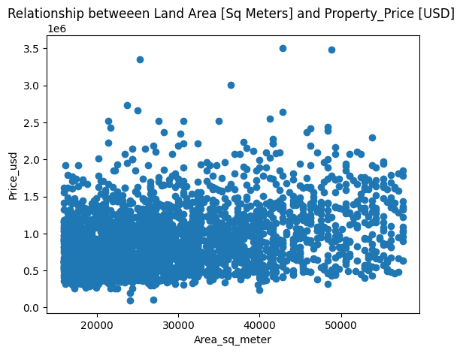
Correlation Analysis:
Spearman Correlation Coefficient: 0.305 between building area and market price, indicating a positive weak correlation.
Descriptive Statistics
[ Building Area ]
Range: 4,172.40 square meters.
Mean: 2,875.61 square meters.
Median: 2,560.0 square meters.
Mode: 1.690.0 square meters.
Standard Deviation: 1,080.62 square meters.
Variance: 11,749.36 square meters.
This scatter plot shows the relationship between Land area and property market price. This figure shows that, there is a weak correlation between land area/ building area and property price. This could be because there are so many driving factors that affect the price of a property especially in Melbourne. Research has shown that properties near the ocean and those near the forest regardless of their size has higher prices than those distant from the sea. In-addition, property type, distance from CBD, region and other factors account greatly for the price of a property. Building area/land area in this case could be a driving factor since there’s a kind of weak correlation but cannot account greatly as a determinant for pricing.

Slide 9
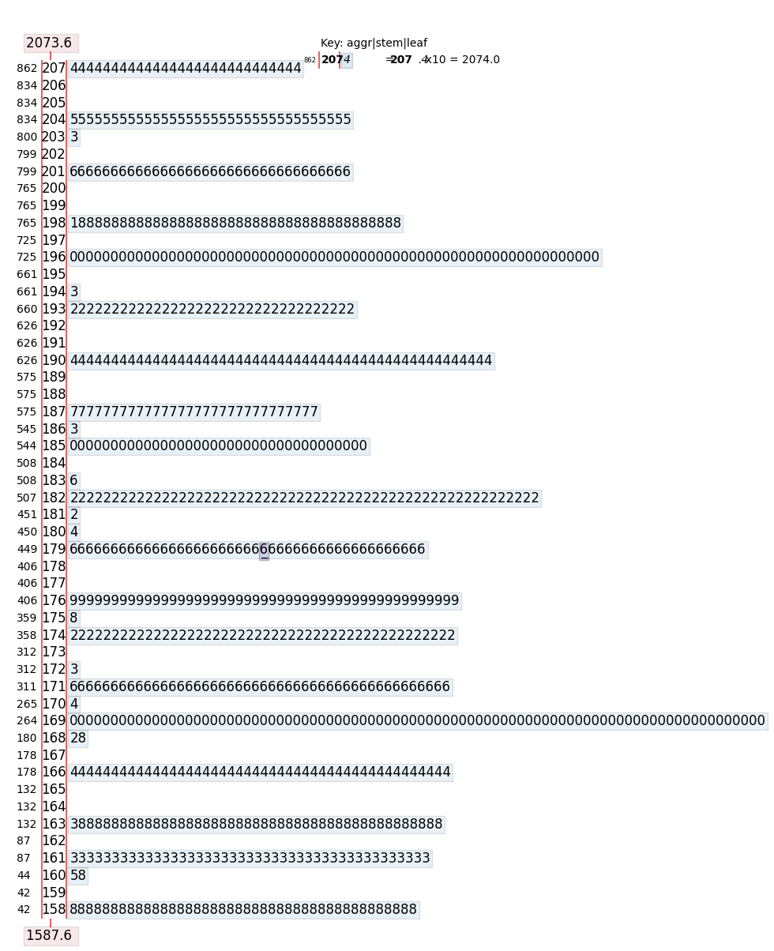
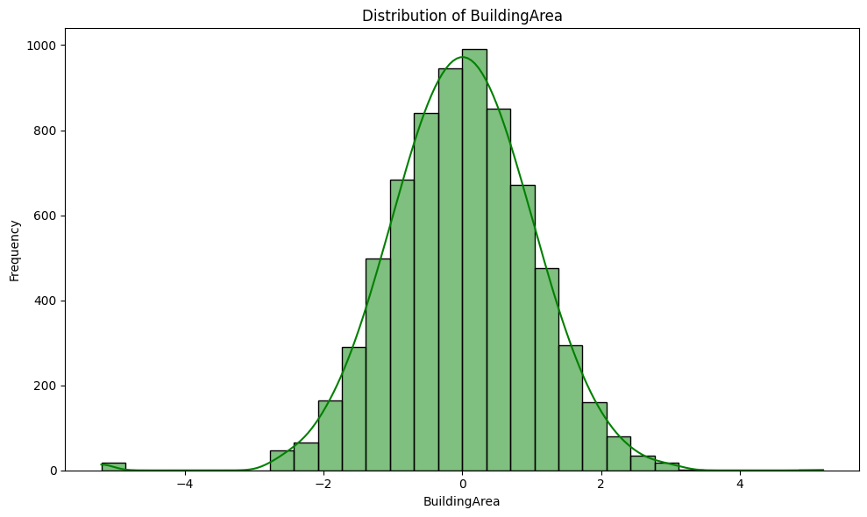
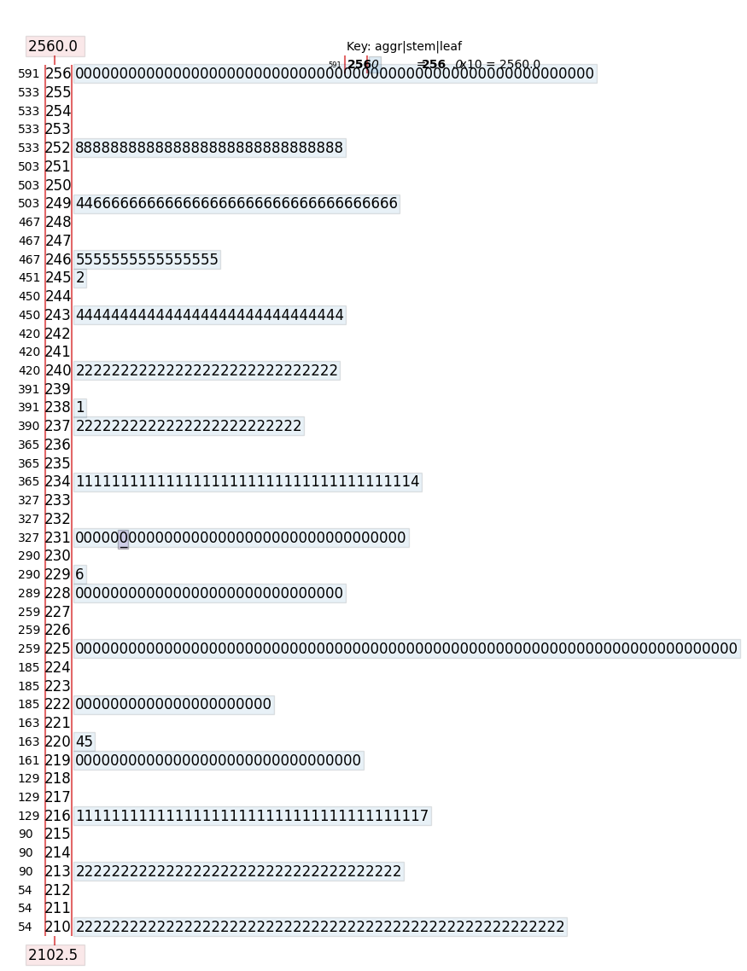
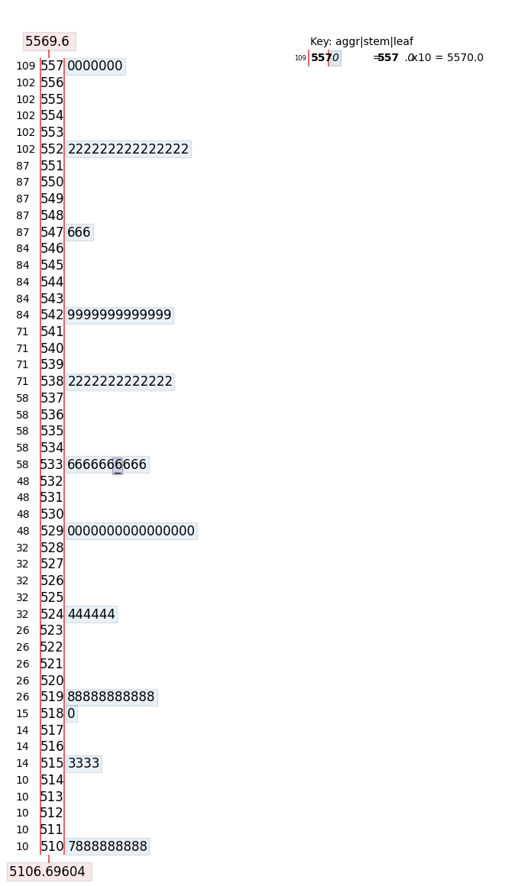
Stem and Leaf Plot: Aggregated building areas to show distribution peaks, indicating common property sizes.“The building area distribution in Melbourne has a median of 2560 sq_m with 10-15 peak values (e.g., 2640, 1390). The greatest peak is 1690 sq_m. The range is 4172.40 sq_m, indicating wide dispersion. Most areas cluster around 1600-2600 sq_m, with a mean of 2875.6 sq_m, mode of 1690 sq_m, and right-skewed distribution, suggesting smaller common building areas.
Normal Distribution Curve: Transformed using Quantile Transformer in converting skewed distribution of building areas’ to a normal distribution.
The histogram shows a bell-shaped curve, indicating an approximately normal distribution of building areas. This suggests that most building areas cluster around a central value, with mean, median, and mode coinciding. The symmetric spread around the mean indicates consistent variability, while a small bar to the far left highlights outliers with unusually low building areas.

Slide 10
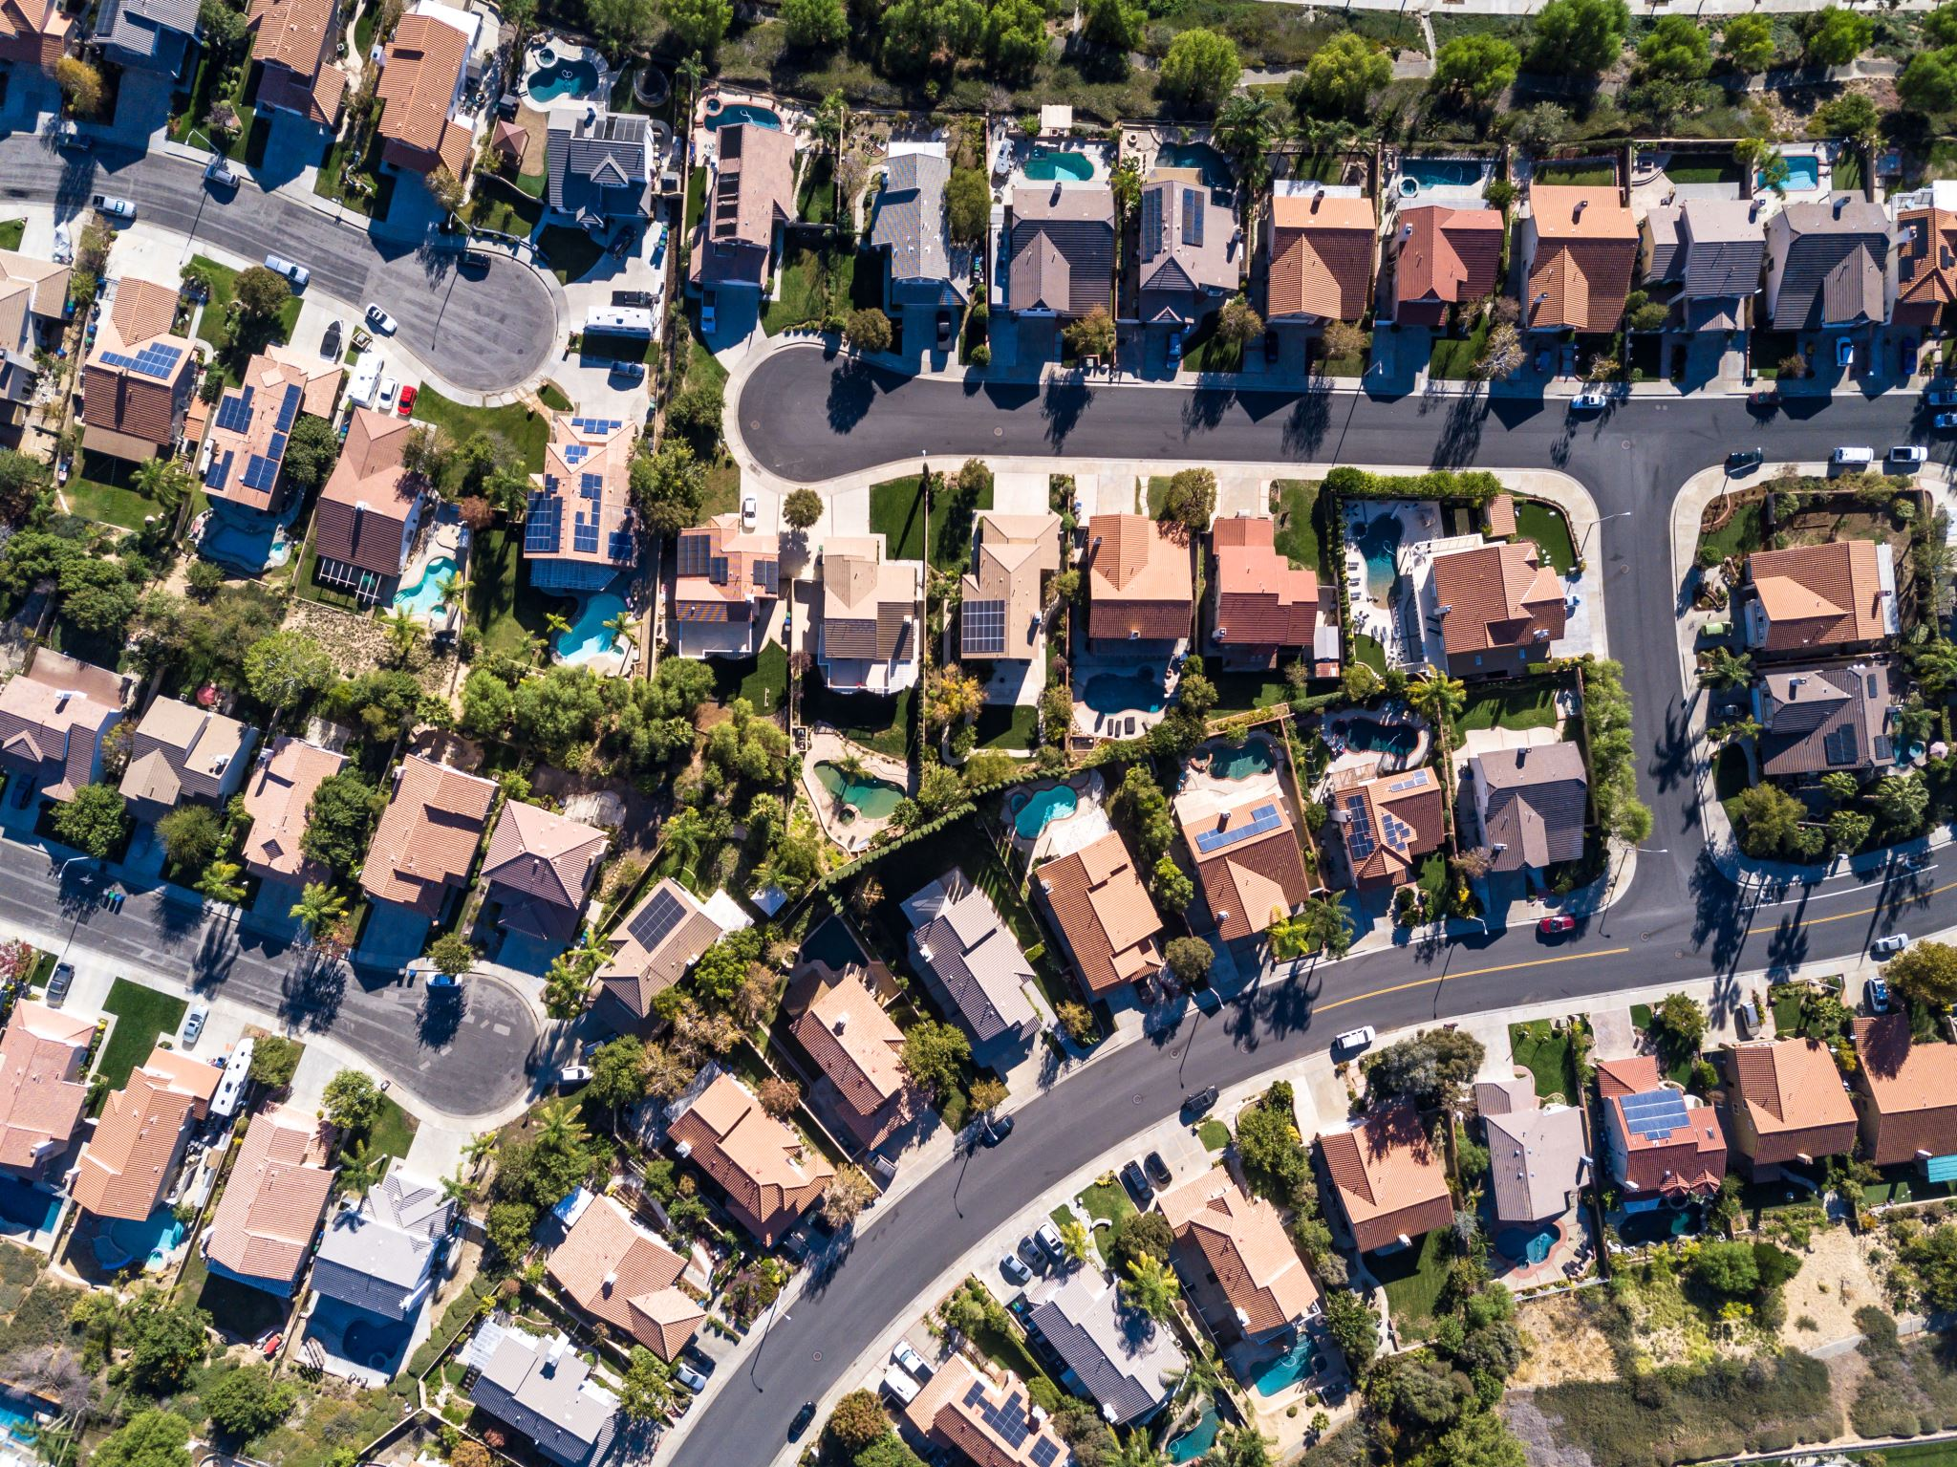
Inference From the Analysis
1. Most Expensive Region: Southern Metropolitan with a mean market price of $1,043,705.
2. Property Type with Highest Price: Houses (house/cottage/semi-detached/villa/terrace) with a mean market price of $935,245.
3. Location Analysis: Properties closer to CBD and in premium regions command higher prices.
4. Building Area Impact: Weak correlation with market price, suggesting that Building Area is a weak determinant of property price, other factors like location and property type are more significant.

Slide 11
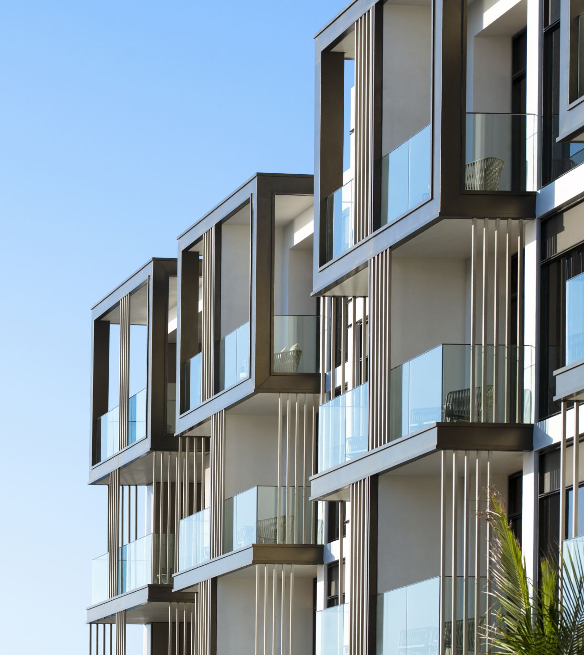
Conclusion
Our analysis highlighted key trends in the Melbourne real estate market, providing insights for buyers, sellers, and real estate agents. Future research could expand on these findings by incorporating more variables such as suburb, bathrooms, rooms, kitchen size address, real estate agents etc.
Recommendations
Agents should consider building properties close proximity to CBD. Since building size is not a key determinant of property price, real estate developers in Melbourne should look keenly into utilizing small area but considering factors such as region (Southern & Eastern Metropolis), closeness to Port Phillip, and considering property type; house/cottage/villa/semi-detached/terrace.

